Slide 1
ZUKUNFT DES HR: KI ALS GAMECHANGER?
^{CHANCEN UND HERAUSFORDERUNGEN}
Montag, 7. April 2025, 18.00 Uhr
Siemens Campus Zug

Slide 2
HERZLICH WILLKOMMEN
Begrüssung
Claudia Pittner Geschäftsführerin Zuger Wirtschaftskammer

Slide 3
Einführung
Alexander Senn Leiter Ausschuss Bildung und Personal Zuger Wirtschaftskammer Head of People & Organization Siemens Smart Infrastructure

Slide 4
DIE JAHRHUNDERT-HERAUSFORDERUNG
Keynote
Selçuk Boydak CEO und Gründer AI Business School

Slide 5
«Die Jahrhundert-Herausforderung für HR-Leader und die Geschäftsführung»
Zug, 7. April 2025

Slide 6
GenAI has democratized the use of AI
Before GenAI
Today
Classic AI solutions like machine and deep learning were primarily designed and operated by highly specialized experts like data scientists and ML engineers
Powerful AI solutions have become literally accessible for everyone in both dimensions:
direct practical use of standard AI tools
creation of bespoke AI solutions based on modern no-code tools

Slide 7
Text-to-action and prompting
Text
generation
Image creation
Video creation
Code generation
Speech generation
Sound generation
…

Slide 8
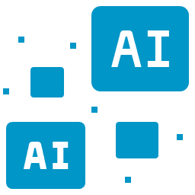
Technology innovation of unprecedented speed
Agent
Swarms
Autonomous Agents
Agentic Workflows
Artificial Intelligence
AI Chatbots
LLM’s

Slide 9
Two ways to leverage AI in an enterprise environment
Standardized
«off-the-shelf» productivity tools
Tailor-made company-specific AI solutions

Slide 10
Benefits of becoming more productive
Faster
Better
More Efficient

Slide 11
Example: impact of Microsoft AI services on business professionals
Ø individual productivity gains over time

Slide 12
Example: GitHub Copilot
55%
46%
75%
Faster Coding
Code accepted
Increased satisfaction
25% - 35%
Productivity Gains

Slide 13
The most important key for the AI transformation is:
PEOPLE

Slide 14
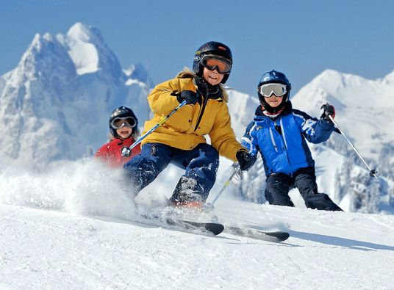
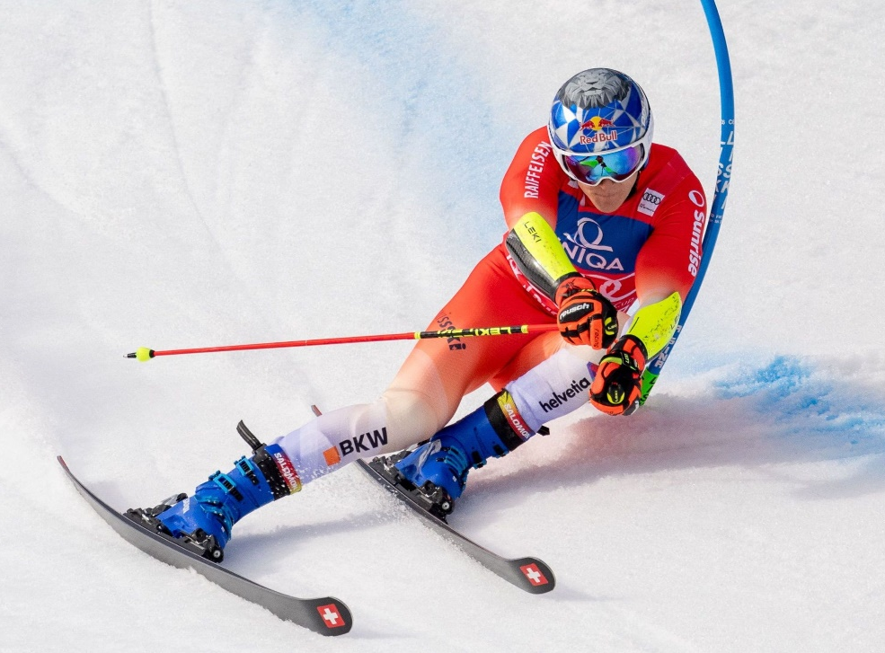
Mass vs. competitive sports

Slide 15
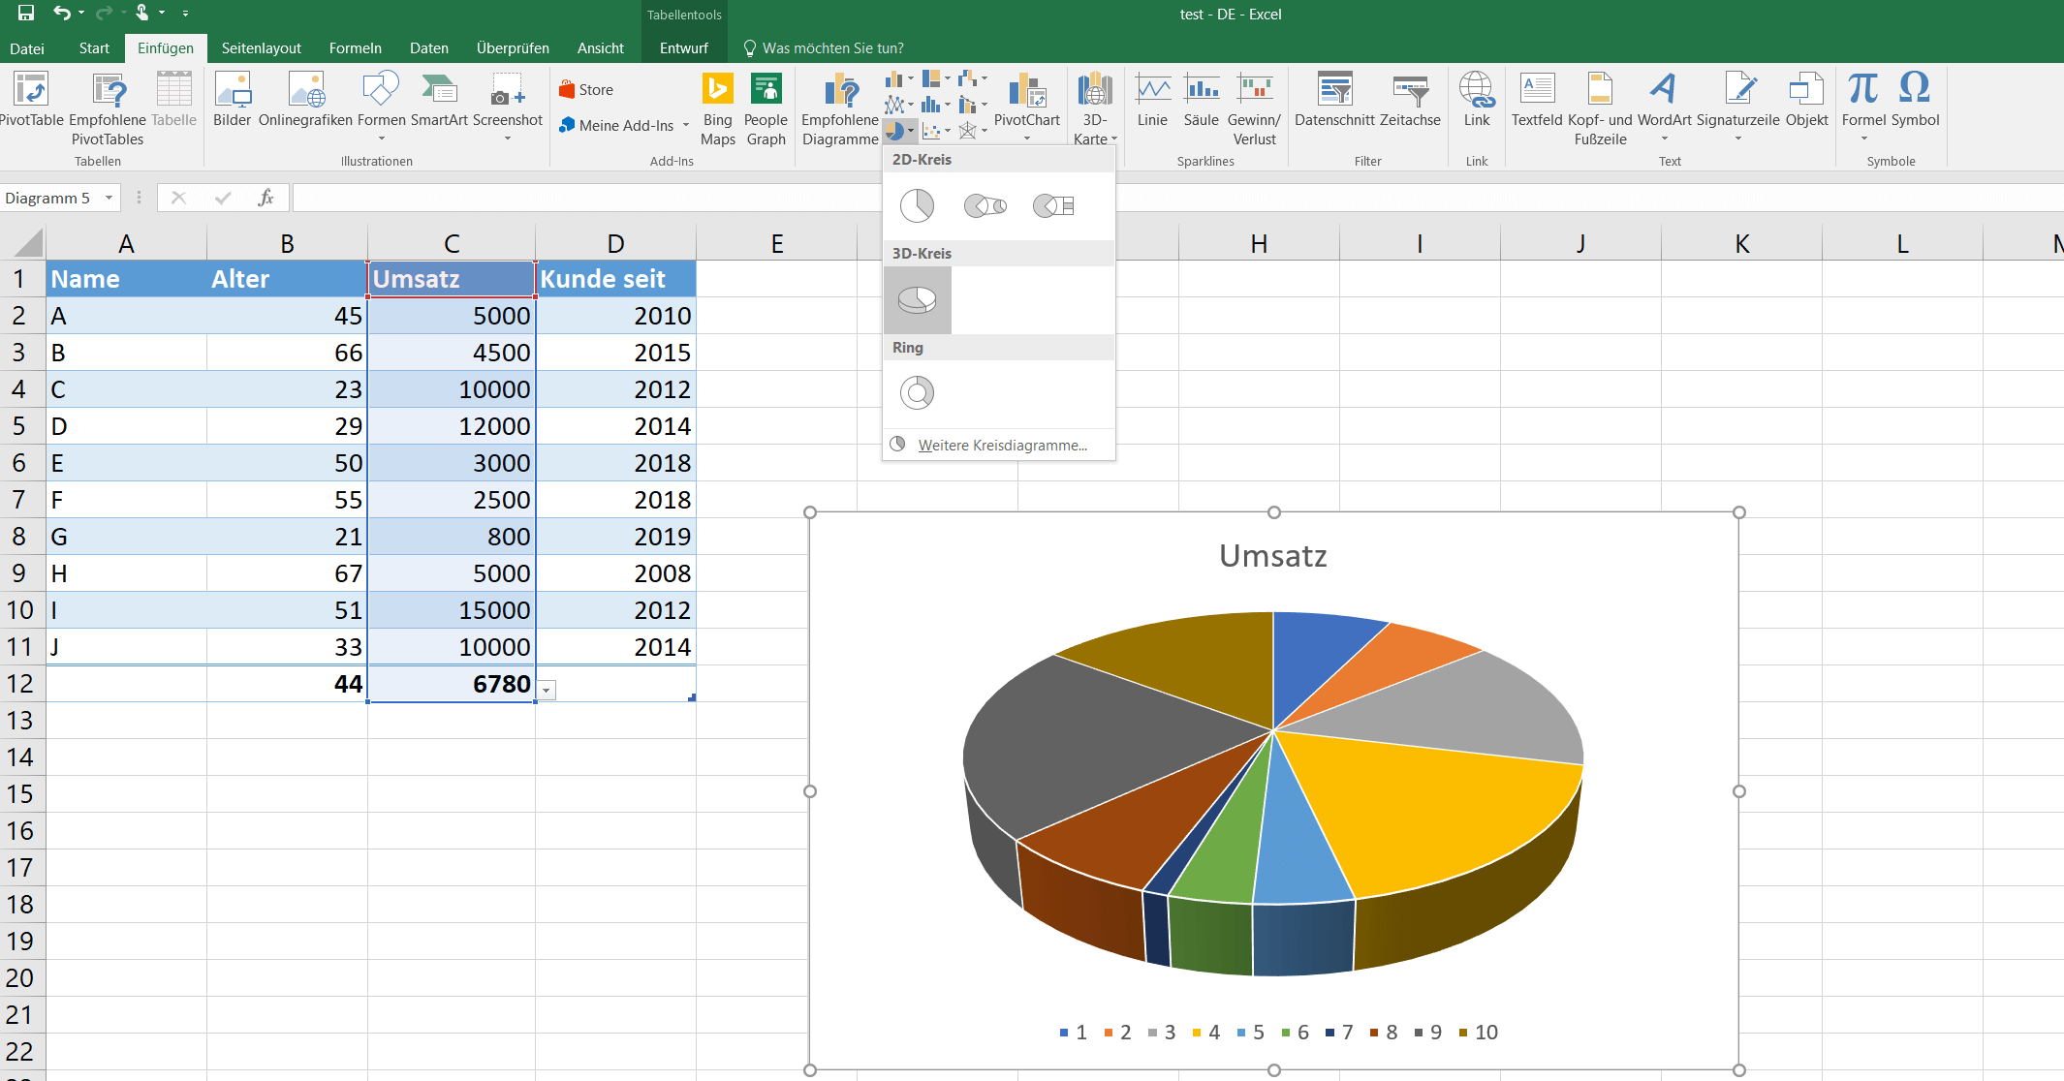
What if …

Slide 16
The current reality of most enterprises
AI Adoption Gap
Available AI tools
Enterprise reality
Standardized
«off-the-shelf» AI tools
Lack of confidence to act courageously and bold
Tools to create bespoke AI solutions
Lack of understanding of how to leverage AI in daily job routines

Slide 17
The major challenge
To ignite a broad AI grassroot movement
AI Skills
Enable and scale the company-wide, role- specific use of standard AI productivity tools
People empowerment
Create a fertile ground for identifying, designing and successfully implementing bespoke AI solutions

Slide 18
People empowerment has to embrace all parts of the entire workforce
Sales
Marketing
Customer Care
Finance
HR
Operations
Supply chain
…
~95 %
Business professionals
~5 %
Technical professionals

Slide 19
3 crucial success factors to achieve a broad mobilisation and active engagement
Job- / role-specifc
Personalized
Interactive / hands-on

Slide 20
AI Business School
Swiss technology firm (since 2018)
Market leader for
Highly personalized, job-specific and interactive AI Trainings
Acceleration of large-scale AI Adoption
Achieving and measuring the impact: Return on AI (RoAI)
Strategic partnerships

Slide 21
3-stage-approach
Ambition / intensity
Select top talents
NextGen Frontrunner program
Select most active participants
Structured ongoing trainings to become active users and even creators and innovators
Short introduction course for everyone to qualify participants
Size

Slide 22
Outcome: massive mobilization of the entire organisation Typical average results within the first 6 months
Overall mobilization
70-90 % of the workforce making regular use of AI
Train
Apply
Create
Innovate
4-5
successful certifications per user
70-100 AI transactions per user
2-3 custom AI apps & workflows created per user
2-3
company-specific use case ideas shared by each user
Impact on personal job satisfaction
70-90 % of users confirm a positive impact
Productivity gains
2-3 hours per user & per week freed up through AI

Slide 23
The sustainable value created
Individual-level
Enterprise-level
Personal AI skills and readiness will be essential to maintain personal job security and viability as well as enhance personal career opportunities
An AI-ready workforce will be THE major competitive advantage in a rapidly changing world and will ensure optimal levels of enterprise
agility & speed
innovation power
productivity & efficiency
competitiveness

Slide 24
The once-in-a-lifetime opportunity
1
2
Leverage AI to transform HR
Take the lead for a company-wide «People-centric AI Transformation»

Slide 25
Are you ready to take the lead?
… as an active shaper of tomorrow

Slide 26
Contact
Selçuk Boydak
AI BUSINESS SCHOOL
Kantonsstrasse 56
8807 Freienbach
Switzerland
sb@aibusinessschool.com
https://aibusinessschool.com/

Slide 27
Übungsanleitung für die Gruppenarbeiten
1
2
Was sollte die KI- Ambition der HR sein?
Was hält uns davon ab, damit loszulegen?
AI nutzen, um HR zu transformieren
Die (Mit-) Federführung für eine «People-centric AI Transformation» in die Hand nehmen
Beides zugleich

Slide 28
WRAP-UP und SCHLUSSWORT
Alexander Senn Leiter Ausschuss Bildung und Personal Head of People & Organization Siemens Smart Infrastructure

Slide 29
APERO und NETWORKING
offeriert von Siemens Smart Infrastructure

